Slide 1
Dark Matter The Problem and a Solution ANPA Online 2022 by Albrecht Giese, Hamburg
Dark Matter
1

Slide 2
Dark Matter
Dark matter
For the physical community this is presently the most urgent / pressing problem of physics.
Problem is well established since 90 years
But there is no theory in the air which could possibly explain the phenomenon
So, panic?
‘
2

Slide 3
Dark Matter
What is the Problem of Dark Matter?
Observations show gravity effects around galaxies deviating from Newton and Einstein
It is an excess of gravitation in relation to Newtonian physics.
This excess cannot originate in baryonic matter
which is generally assumed to cause gravity.
‘
3

Slide 4
Dark Matter
The Cases of Dark Matter:
Main cases are
rotations of galaxy clusters and
stars around galaxies
which are too fast with relation to the masses involved.
And, apart of this, there are further, different cases.
‘
4

Slide 5
Dark Matter
The Dark Matter Theories:
We will present a solution here which solves all cases and is in conflict with no case.
The way:
All cases of dark matter
have a common property which is ignored by the physicists
‘
5

Slide 6
Dark Matter
Now:
The main and historically original cases of dark matter:
Rotation of galaxy clusters
Rotation curves of stars around galaxies
‘
6

Slide 7
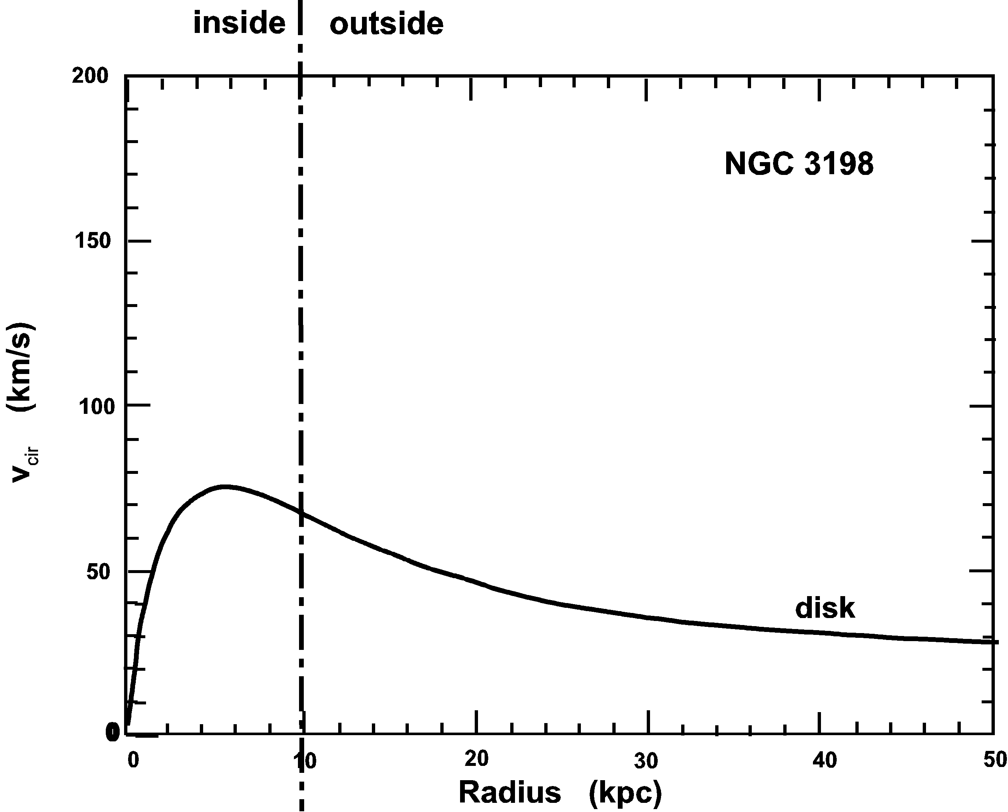
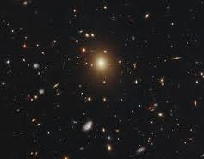
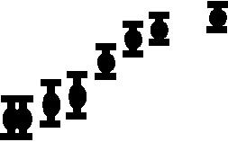
Dark Matter
The master cases of Dark Matter
The great rotating Cluster A2261
Rotation around GNC 3198
?
Rotation speed is too fast in both cases
‘
7

Slide 8
Dark Matter
Further indications of Dark Matter:
Too fast generation of stars and clusters
Allocation of dwarf galaxies along disk layer
Nucleogenesis
Bullet cluster
Renzo’s rule
‘
8

Slide 9
Dark Matter
The Dark Matter Theories:
Theories in discussion:
MOND: Modified Newton dynamics
- i.e. the law of gravity changes from 1/r2 to 1/r at a certain distance from core of a galaxy or for a certain weakness of the field
Dark particles
- i.e. particles which only interact via gravitation, so not visible
‘
9

Slide 10
Dark Matter
The Dark Matter Theories:
1) Problems with MOND
No physical reason for a change 1/r2 → 1/r at a specific low field
For galaxies of different size the transition field has to be different; - by which physical reason?
Problems with MOND:
‘
10

Slide 11
Dark Matter
2) Dark particles:
Dark particles
- i.e. particles which only interact via gravitation, so not visible
Portion of DM Particles:
16 % Normal (baryonic) matter = 1/6
84 % Dark matter = 5/6
These numbers are questionable. We will come back to them.
‘
11

Slide 12
Dark Matter
The Dark Matter Theories:
Problems with Dark particles
No indication of existence – despite intensive search
Bullet cluster – not compatible with heavy particles
Peak distribution in the centre of galaxies – not observed
DM should peak in the centre of dwarf galaxies but is flat
‘
12

Slide 13
Dark Matter
The Dark Matter Theories:
Intensive search for a new particle:
A big number of experiments presently running searching them.
Up to now not the faintest indication of anything
‘
13

Slide 14
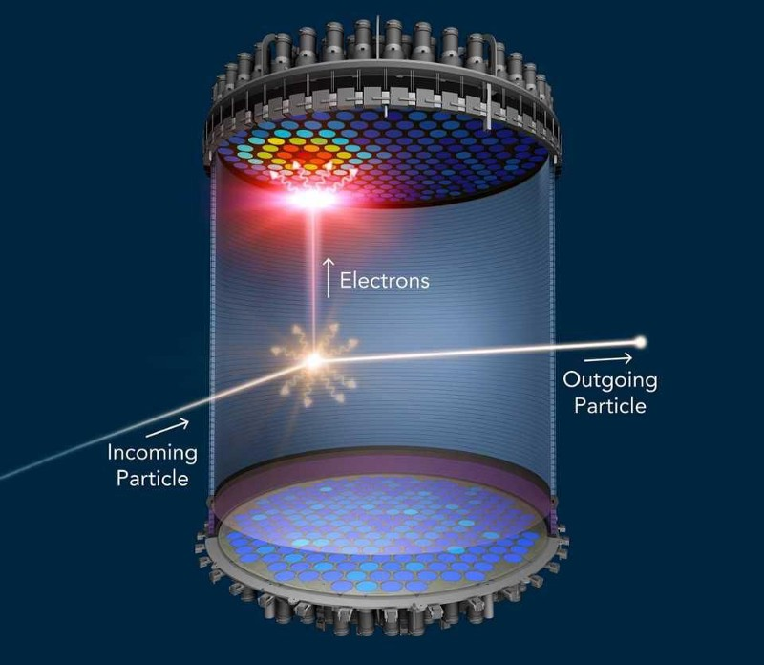
Dark Matter
Search for “dark” particles
Experiment: Lux-Zeplin with a team of 250 scientists / engineers
Uses 10 tons of liquid Xenon
Is said to be the most sensitive device for the detection of axions
‘
14

Slide 15
Dark Matter
Direction of a solution
The density of the distribution of dark matter:
„is very specific“
‘
15

Slide 16
1) Rotation of the Galaxy NGC 3198
Dark Matter
?
density distribution of photons: ρ ∝ 1/r2
halo
(of dark matter)
assumed density distribution of DM particles: ρ ∝ 1/r2
following Newton
‘
16

Slide 17
Dark Matter
2) The Dark Matter in Clusters
Identified by
Gravitational Lensing
The Clash cooperation has investigated the dark matter distribution in the Galaxy Cluster A2261
They produced a mapping of dark matter
‘
17

Slide 18
Dark Matter
Clash investigation of galaxy cluster A2261
The cluster comprises ∼ 300 galaxies
Sophisticated programs determine the parameters of the light sources and the deflection and so the density of dark matter.
‘
18

Slide 19
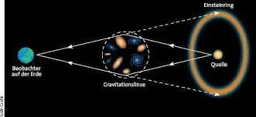
Dark Matter
Gravitational Lensing
Light is deflected in a gravitational field.
From the deflection it is possible to determine the gravitational field. And that is a stronger one than the visible matter can cause.
The excess of the gravitational field compared to the classical one is assigned to the dark matter.
From determinations like this, one can find the spatial distribution of the dark matter and build maps of it.
‘
19

Slide 20
Dark Matter
„CLASH“ investigation of Cluster A2261
Mix of baryonic and dark matter - gas
Pure dark matter
Slope = 1/r2
For the density of dark matter
R_{galaxy}
‘
20

Slide 21
Dark Matter
Conclusion from both cases:
Rotation curves and galaxy clusters:
Both have a density distribution of dark matter following
1/r2
from the centre of galaxy / cluster.
… which is here also the center of the luminosity.
⇒ This is the same density distribution as for photons.
What can we conclude?
‘
21

Slide 22
Dark Matter
Conclusion of both cases:
This means physically that
the distribution of dark matter is the same
as the distribution of photons.
Can there be a pairing between dark matter particles and photons?
NO, that is not possible. Photons move at c whereas massive dark matter particles cannot.
Radical solution: Photons are the particles of dark matter:
⇒ The theory of gravitation has to be different →
Gravity has to be independent of mass
Every elementary particle contributes equally to the field
‘
22

Slide 23
Rotation of the Galaxy NGC 3198
Dark Matter
Now this case calculated on the basis of gravitational photons:
The only assumptions: A photon has a the same gravitational field as a heavy elem. particle (quark)
halo
(of dark matter)
contribution of photons ρ ∝ 1/r2
Result is not only the correct shape of the curve, but the correct height, so the strength of the field
following Newton
This quantitative result is not in the reach of any other theory presently in discussion.
‘
23

Slide 24
Dark Matter
Problems with Dark Matter Particles:
Further problems with dark particles
‘
24

Slide 25
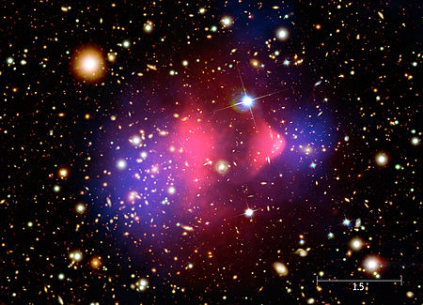
Dark Matter
Problem Bullet cluster
Two galaxies passing each other.
The baryonic matter (red) is slow, the dark matter (blue) is speedy
This is in conflict with massive DM particles because simulations falsify the standard explanation.
‘
25

Slide 26
Dark Matter
Problem dwarf galaxies
Dwarf galaxies are expected to be distributed in a sphere around the mother galaxy. In fact they are in the layer.
This is in conflict with the standard expectation to dark particles.
‘
26

Slide 27
Dark Matter
Problem Renzo’s rule
“For any feature in the luminosity profile there is a corresponding feature in the rotation curve and vice versa”
Means: At parts of a galaxy with less luminosity the rotation speed is reduced … and so the gravitational field
This is a direct indication of a photonic gravity
‘
27

Slide 28
Summary to this point
Dark Matter
A. The present model of dark matter particles explains some cases, but is in conflict with others
B. The theory MOND explains only few cases but is in conflict with others
Conclusion: none of these can be correct.
C. The photon model
explains all occurring cases and is with no case in conflict
provides quantitative results in contrast to all other theories
but requires an altered theory of gravitation which, however, solves also other questions.
‘
‘
28

Slide 29
Dark Matter
My personal history:
I did not find this theory of gravitation to solve the dark matter problem.
But the other way around.
Extension of Lorentzian relativity → Gravitation
Lorentzian gravitation not depending on mass
⇒ Lorentzian gravitation explained the DM problem
‘
29

Slide 30
Dark Matter
The next step:
Gravitation without mass
‘
30

Slide 31
Dark Matter
The next step: Gravity without mass
Why is gravity related to mass?
For Newton gravity was obviously related to matter.
Newton did not have an alternative to mass to characterize matter. Elementary particles were unknown at his time.
The new theory:
Einstein initially started a new approach for gravitation (1911)
Starting point: The speed of light c is reduced in a gravitational field
But Einstein’s equation for c was wrong (Δc not taken as direction dependent)
Einstein returned to the Newtonian understanding, i.e. mass causes gravity – and he produced his theory based on curved space-time
But: with the correct equation all aspects of gravitation can be deduced including the relativistic ones – so the results are according GRT
So gravitation as independent of mass is a proper solution
‘
31

Slide 32
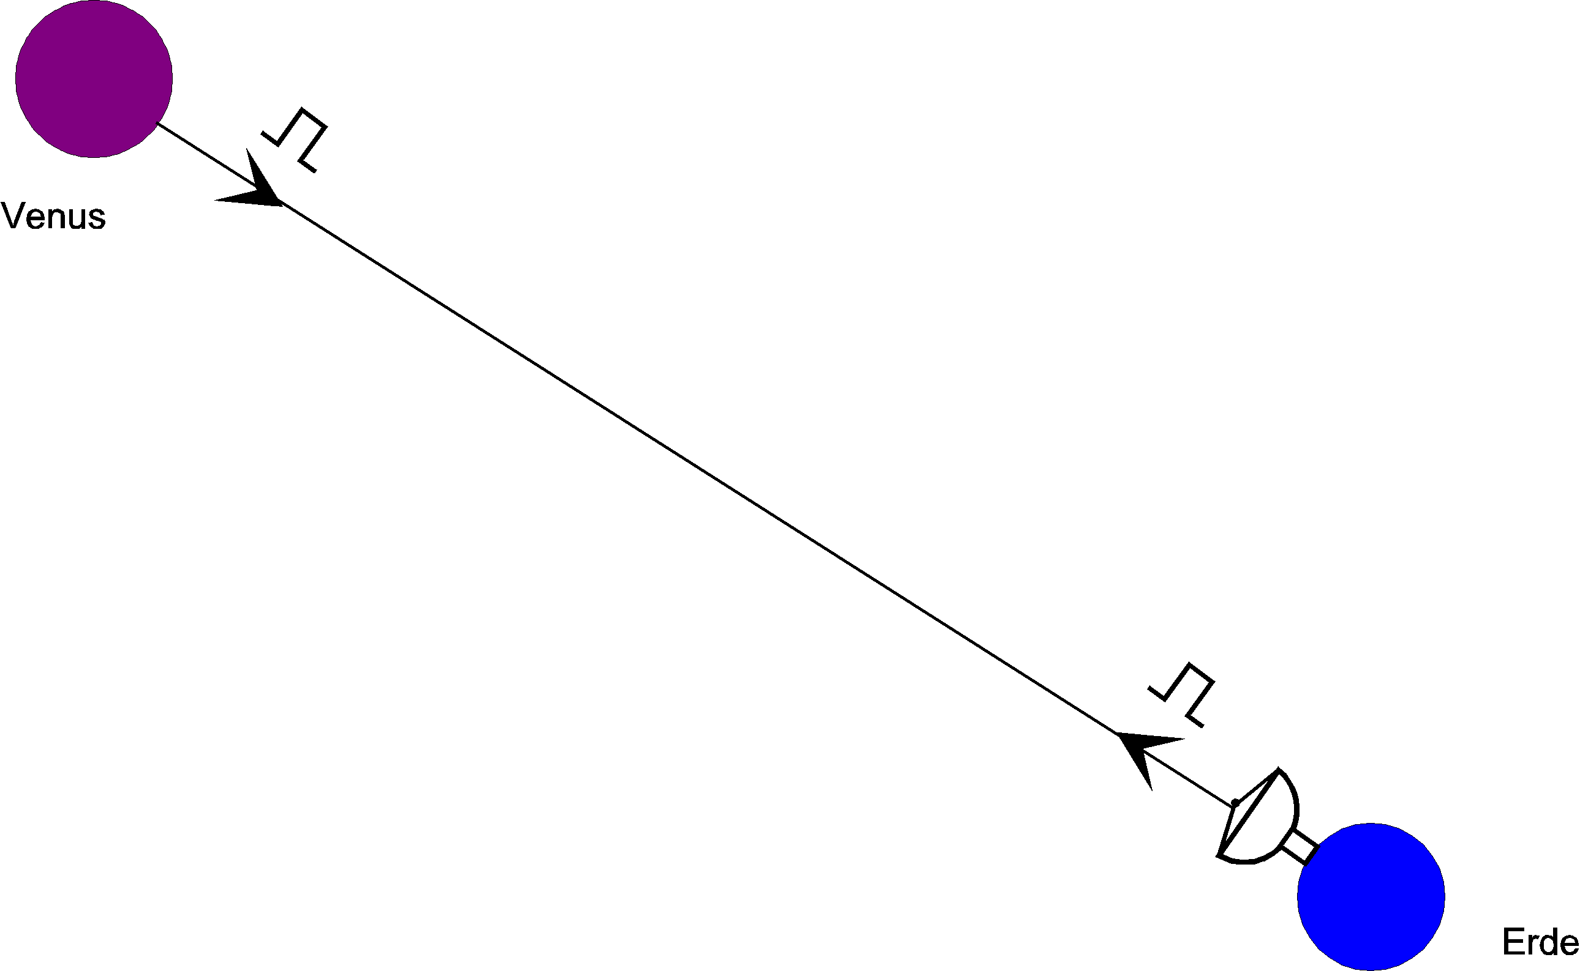
The Shapiro-Experiment:
Dark Matter
c
⁄
⁄
c
p= 1/2 or 1 depending on direction
‘
32

Slide 33
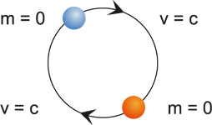
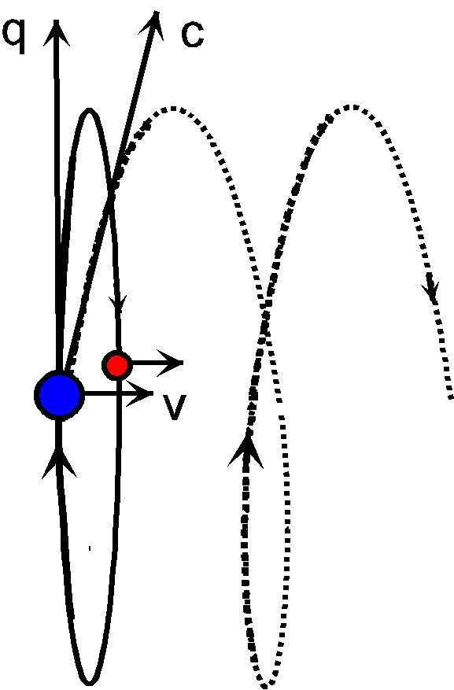
Dark Matter
The unneeded space-time
Particle model with internal oscillation
ν = E / h
.
(Einstein / Planck)
v = c
(Dilation)
orbit
(Spin, mag. moment)
N = 2
(Momentum law)
m = 0
(Relativity)
This internal oscillation causes dilation and is anyway a necessary property.
Note: this particle model yields the mass of elementary particles very precisely
e.g. the mass of the electron better than 10-5
‘
33

Slide 34
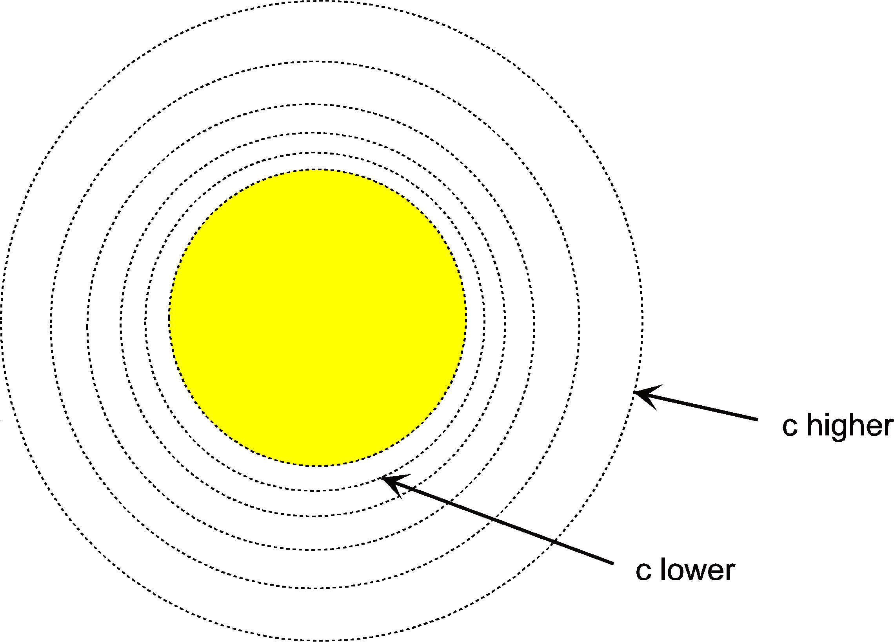
The gravitational field of the sun:
Dark Matter
The unneeded space-time
α
Physically:
P=1/2 or 1 depending on direction
The application of classical refraction yields for the vertex:
Newton
Integrating deflection 2α from – ∞ to + ∞ yields: 1.75 arcsec
…. with Newton: 0.88 arcsec
Einstein
Now: Acceleration at rest!!
This was the great breakthrough for Einstein in 1919 (Solar eclipse)!!
‘
34

Slide 35
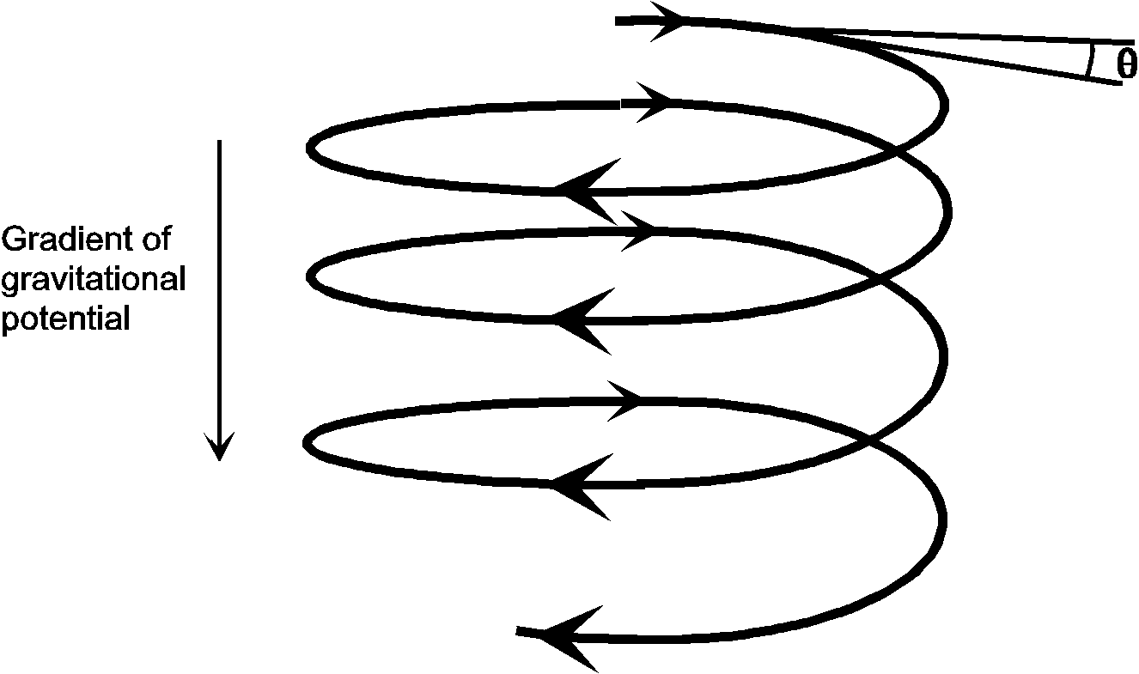
Elementary Particle in a Gravitational Field (with Vertical Axis):
The Origin of Gravity
c
c
No dependency on the mass!
Gravit. Source
‘
35

Slide 36
Dark Matter
What is Gravity?
♦ Gravity is the change of the speed of light in the vicinity of an object
But: What is the physical reason for the change of the speed of light ‘c’ in the vicinity of an object?
‘
36

Slide 37
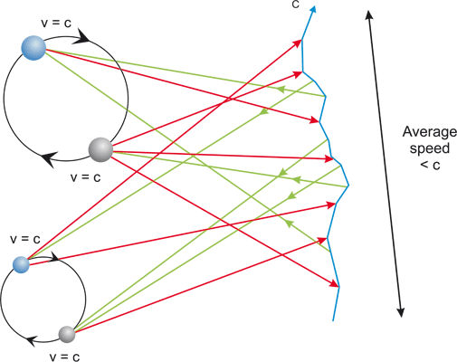
Dark Matter
Why is ‘c’ reduced?
by the perturbed path of a light-like particle
c
⇒
p = ½ or 1
Average speed < c
N = number of particles
replaces:
Reduction of c independent of Radius
⇒ Gravity is independent of mass
This is in contrast to Einstein, who followed a principle (energy).
‘
37

Slide 38
Dark Matter
Formal Treatment of General Relativity (Gravity)
Schwarzschild Solution:
is the starting point for the classical proofs of General Relativity:
Perihelion Advance
Gravitational Lensing
Black Holes
…
‘
38

Slide 39
The Origin of Gravity
Formal Result of General Relativity (Gravity)
Reduced speed of light c
for radial motion
for tangential motion
Reduced field distance
in radial direction
Lorentz Transformation (time-related)
Speed split into radial/tangential portion
Now Gravity:
Schwarzschild Solution
‘
39

Slide 40
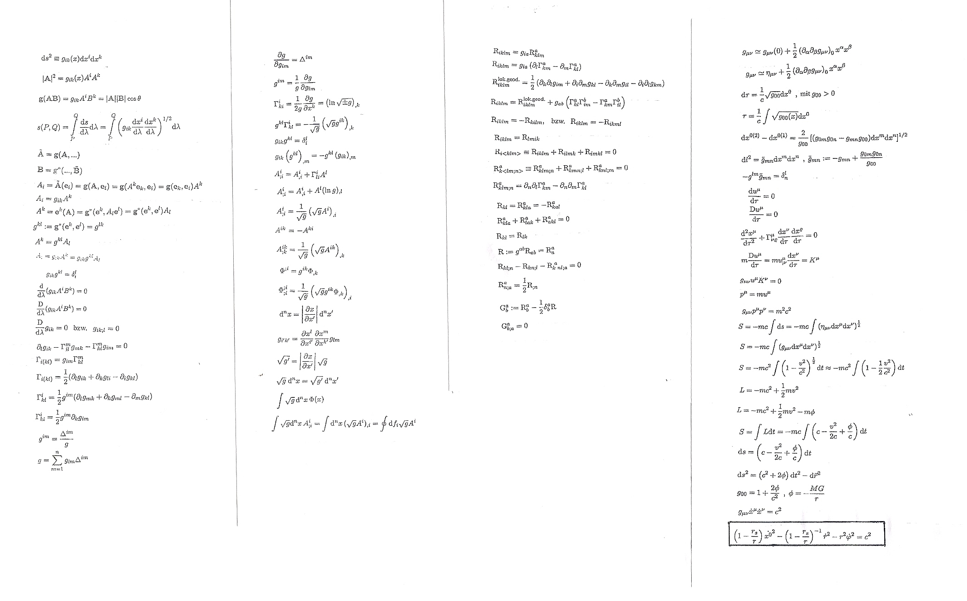
The Origin of Gravity
Riemann Geometry
Field Equations
‘
40

Slide 41
The Origin of Gravity
Formal Result of General Relativity (Gravity)
Reduced speed of light c
for radial motion
for tangential motion
Reduced field distance
in radial direction
Lorentz Transformation (time-related)
Speed split into radial/tangential portion
Now Gravity:
Schwarzschild Solution
‘
41

Slide 42
Summary
Dark Matter
The result for the question of dark matter is:
A. The present model of dark matter particles explains some cases, but is in conflict with others
B. The theory MOND explains only few cases but is in conflict with others
Conclusion: none of these can be correct.
C. The photon model
explains all occurring cases and is with no case in conflict
provides quantitative results in contrast to all other theories
but requires an altered theory of gravitation which, however, solves also other questions.
‘
‘
42

Slide 43
Basing Relativity on Physical Processes
The End
‘
43

